Slide 1

Design Project A
1
Team Orange
Samvit Acharya - Sacha Béraud – Ian Zhang

Slide 2
Team Structure
2
Samvit Acharya: Computer Engineering
Strengths: IC design, HCI, software, team management and planning, quick learner, good self-discipline
Weaknesses: Certain portions of hardware design.
Proposed Task: Project manager, hardware (VHDL and circuitry),
software(front-end)
Sacha Béraud : Computer Engineering
Strengths: Java, VHDL, design, more efficient under stress
Weaknesses: Average time management, but not when working in a team
Proposed Task: hardware (VHDL and circuitry), IC design,
version control management
Ian Zhang : Software Engineering
Strengths: Java, OO programming, project planning, fast learner
Weaknesses: Hardware design, VHDL, analog circuit design
Proposed Task: Computer Interface Software (back-end),
PC-Board Communication

Slide 3
Digital VS Analog
3
Attribute | Digital | Analog
Price | Higher | Lower
Implementation Complexity | Easier | Harder, needs circuit, ADC, etc
Versatility | Less adaptable to change in specs or unplanned issues during project | More adaptable
Presence in this type of electronic project | Less Frequent | More Frequent
Candidates | DHT11, RHT03/DHT22 | HSM20G, HTF3223

Slide 4
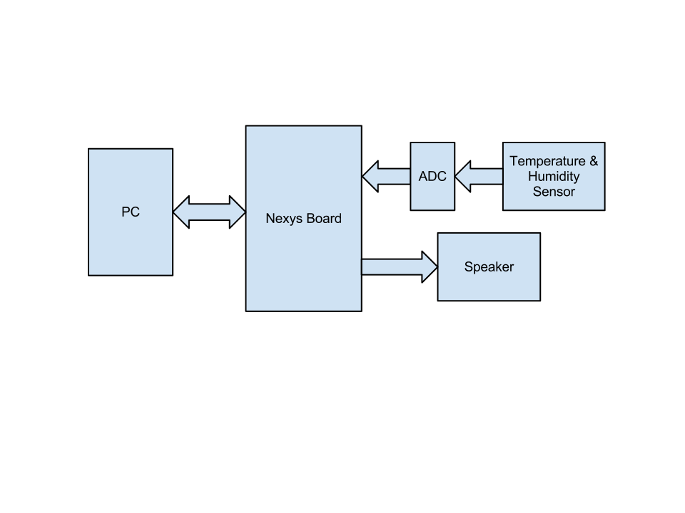
Block Diagram
4

Slide 5
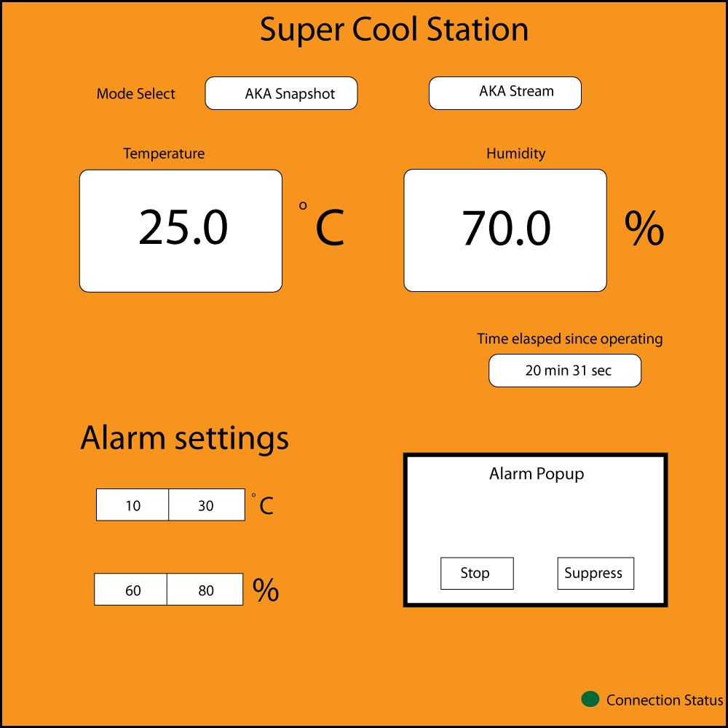
GUI Draft
5

Slide 6
By next week
6
Hopefully received and tested sensors.
Initial FSM implemented and simulated.
PC-Board communication : connection status, device name, various response tests.
Analog circuitry derived and purchased, tested.
Final Gantt Chart, reports.

Slide 7
Reflections
7
Problems Encountered : A bit behind in schedule due to late start, Samvit is just starting VHDL, Ian is just starting C++/Visual Studio, Sacha does not like op-amps.
Solutions : Frequent meetings, fast self-learning, good communication and organization.
Learning Outcome : A good logo always saves the day.

